Slide 1
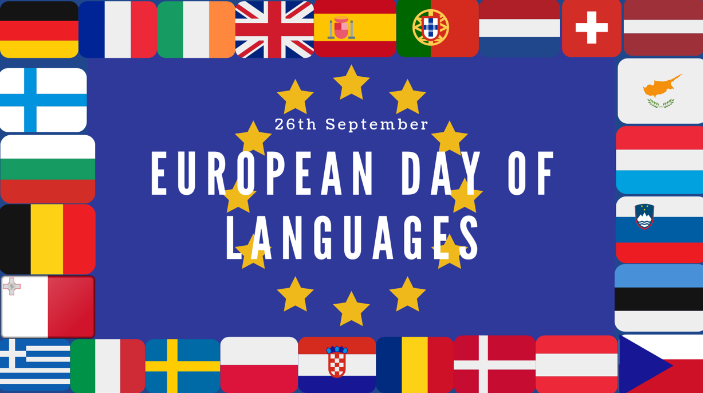

Slide 2
Match the capital city to it’s country
Amsterdam
Athens
Berlin
Bratislava
Brussels
Bucharest
Budapest
Copenhagen
Dublin
Helsinki
Lisbon
12. Ljubljana
13. London
14. Luxembourg
Spain
Cyprus
France
Czech rep
Latvia
Italy
Bulgaria
Sweden
Estonia
Malta
Austria
Lithuania
Poland
Croatia
Netherlands
Greece
Germany
Slovakia
Belgium
Romania
Hungary
Denmark
Ireland
Finland
Portugal
Slovenia
UK
Luxembourg
15. Madrid
16. Nicosia
17. Paris
18. Prague
19. Riga
20. Rome
21. Sofia
22. Stockholm
23. Tallinn
24. Valletta
25. Vienna
26. Vilnius
27. Warsaw
28. Zagreb
Austria
Belgium
Bulgaria
Croatia
Republic of Cyprus
Czech Republic
Denmark
Estonia
Finland
France
Germany
Greece
Hungary
Ireland
15. Italy
16. Latvia
17. Lithuania
18. Luxembourg
19. Malta
20. Netherlands
21. Poland
22. Portugal
23. Romania
24. Slovakia
25. Slovenia
26. Spain
27. Sweden
28. UK

Slide 3
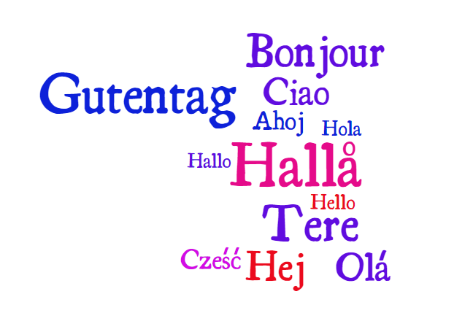
How to say hello in 12 different European languages.
How many languages can you identify?

Slide 4
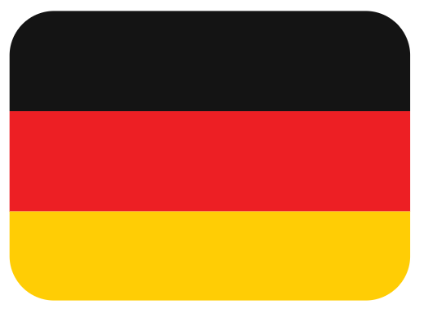
Words that don’t exist in English
The chattering of teeth from the cold or from rage.
The experience of seeing a woman who appears pretty from behind but not from the front.
Excess weight gained from emotional overeating. Literally, grief bacon.
A face badly in need of a fist.
Kummerspeck

Slide 5
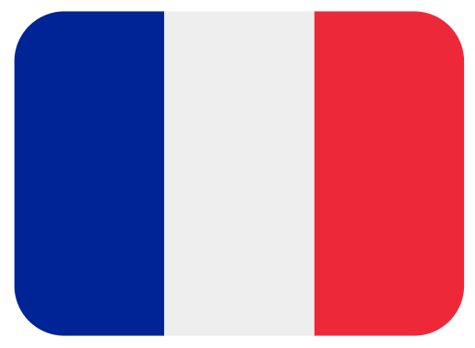
Words that don’t exist in English
Coffee shop dwellers who sit at tables a long time but spend little money.
Addicted to the UV glow of tanning salons? This word describes you.
The sense upon first meeting a person that the two of you are going to fall in love.
Literally, stairwell wit—a too-late retort thought of only after departure.
Seigneur-terraces

Slide 6
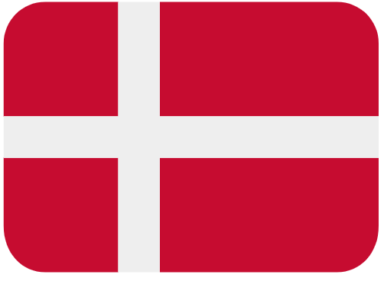
Words that don’t exist in English
An amazing dream. Not just a "good" dream; the opposite of a nightmare.
Hygge is the pleasant, genial, and intimate feeling associated with sitting around a fire in the winter with close friends.
A state of torment created by the sudden sight of one’s own misery.
Tenderly running your fingers through your lover’s hair.
Hygge

Slide 7
Words that don’t exist in English
The act of gazing vacantly into the distance
An impractical dreamer with no business sense
The experience of seeing a woman who appears pretty from behind but not from the front
Literally, stairwell wit—a too-late retort thought of only after departure.
L’esprit de l’escalier

Slide 8
Words that don’t exist in English
A face badly in need of a fist
That feeling you get when you don't want someone to do something for you because it would be a pain for them.
The urge to pinch or squeeze something that is irresistibly cute.
The chattering of teeth from the cold or from rage.
Backpfeifengesicht

Slide 9
Words that don’t exist in English
Tenderly running your fingers through your lover’s hair
Addicted to the UV glow of tanning salons? This word describes you
The prevailing fashion trend among American men under 40, it means one who wears the shirt tail outside of his trousers.
The person who’s stuck carrying everyone else’s bags on a trip. Literally, a burro.
Slampadato

Slide 10
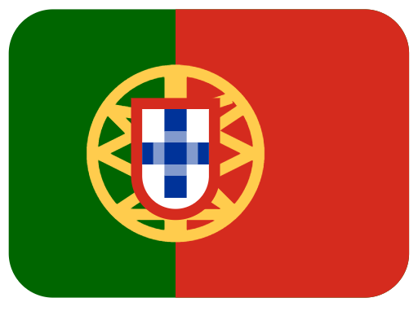
Words that don’t exist in English
The fate between two people.
A heartwarming story that moved you to tears.
The feeling of longing for an absent something or someone that you love but might never return.
The feeling that comes from not being in one’s home country; being a foreigner.
Saudade

Slide 11
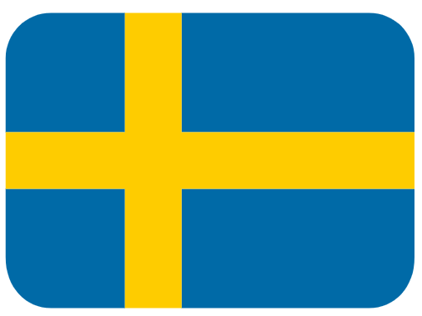
Words that don’t exist in English
Not too much, and not too little, but juuuuust right.
A word made for walking in the woods at night, it’s the phantom sensation of something crawling on your skin.
The urge to pinch or squeeze something that is irresistibly cute.
To make a squeaking sound by sucking air past the lips in order to gain the attention of a dog or child.
Lagom

Slide 12
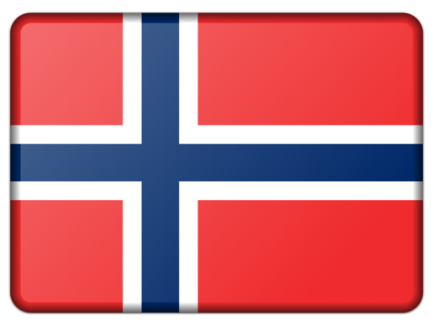
Words that don’t exist in English
The euphoria experienced as you begin to fall in love
A particular type of longing for the homeland or the romanticized past.
A sensation of great spiritual anguish, often without a specific cause; a longing with nothing to long for.
A work of art’s mysterious power to deeply move a person.
Forelsket

Slide 13
Words that don’t exist in English
That feeling you get of homesickness for a place you’ve never ever been to!
That moment when we think of the perfect comeback long after the chance to actually use the comeback!
It means not too much and not too little, but just the right amount.
A feeling of enjoyment that comes from seeing or hearing about the troubles of other people.
Schadenfreude

Slide 14
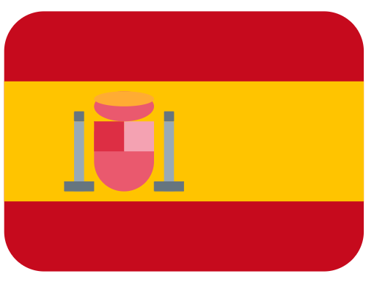
Words that don’t exist in English
Stealing things of little to no value, not because you need them but for the fun of it!
An “inept, bungling person” who is chronically unlucky!
Being flustered to the point of incompetence.
The moment after eating a meal when the food is gone but the conversation is still flowing at the table.
Sobremesa

Slide 15
Our EU neighbours are much better at learning a second language than we are here in the UK. A recent survey in the EU measured the % of 15-30 year olds who say they can read & write in at least one foreign language. Out of the 28 EU member countries, which countries do you think topped the list?
99% Denmark
98% Malta
97% Netherlands
97% Sweden
95% Luxembourg
Out of the 28 EU countries, where do you think the UK came in the list?
Why do you think such a high percentage of people in these countries have learnt a second language?
28/28 – Last place, just 32% of 15-20 year olds in the UK can speak a second language.
What are the benefits of speaking a second language? How would it benefit the country if more of us could communicate with our EU neighbours?

