Slide 1
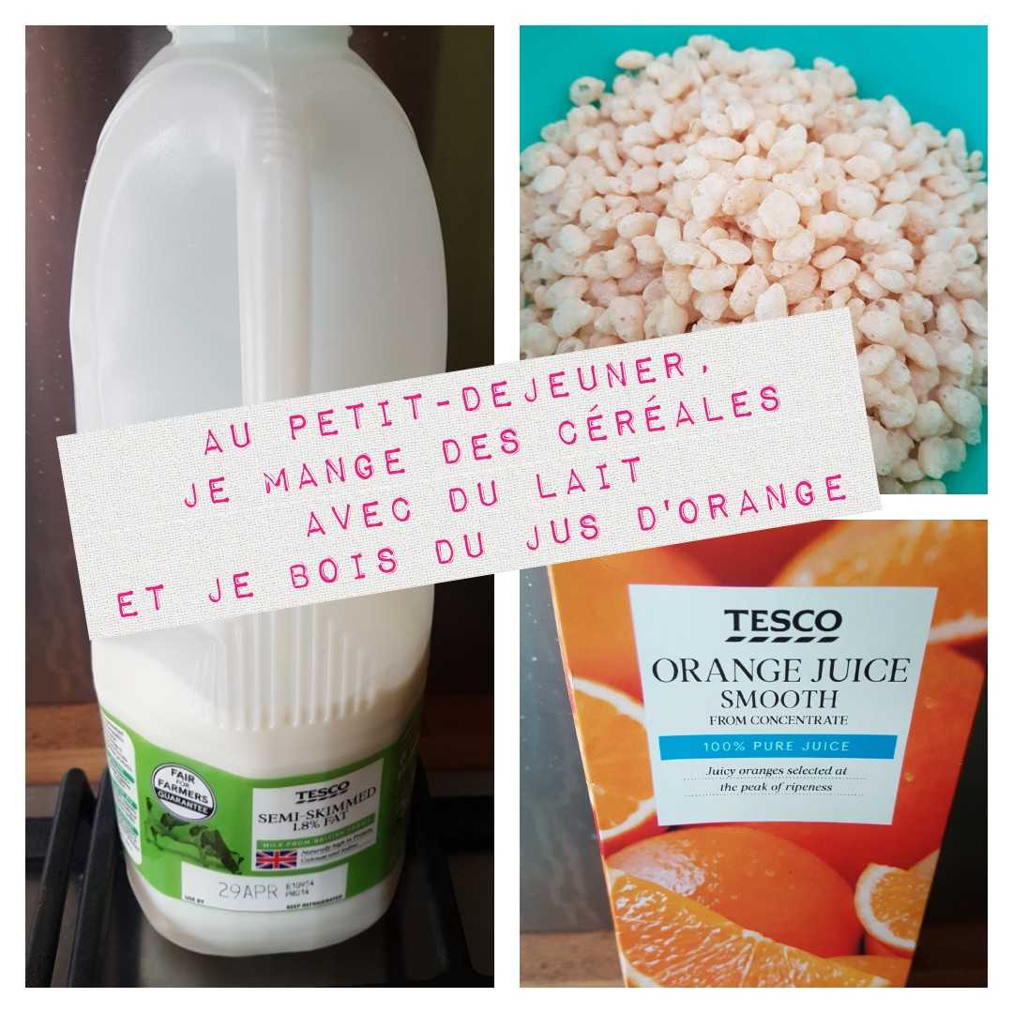
fun activities with a language twist
French Pic-Collage competition
Ce que je mange
Use the following prompts to create photo collages in French and send them back to your teacher for rewards.
You can use any free apps and take your own pictures for ease of use.
Prompts:
Dans mon frigo, il y a…
Mes fruits préférés sont…
Au petit-déjeuner, je mange…
Le midi, je mange…
Hier soir, j’ai mangé…
Pour mon prochain anniversaire, je vais manger…
Example: Au petit-déjeuner, je mange…
Challenge:
Create your own prompts in French!
© We Teach French | www.weteachfrench.co.uk

Slide 2
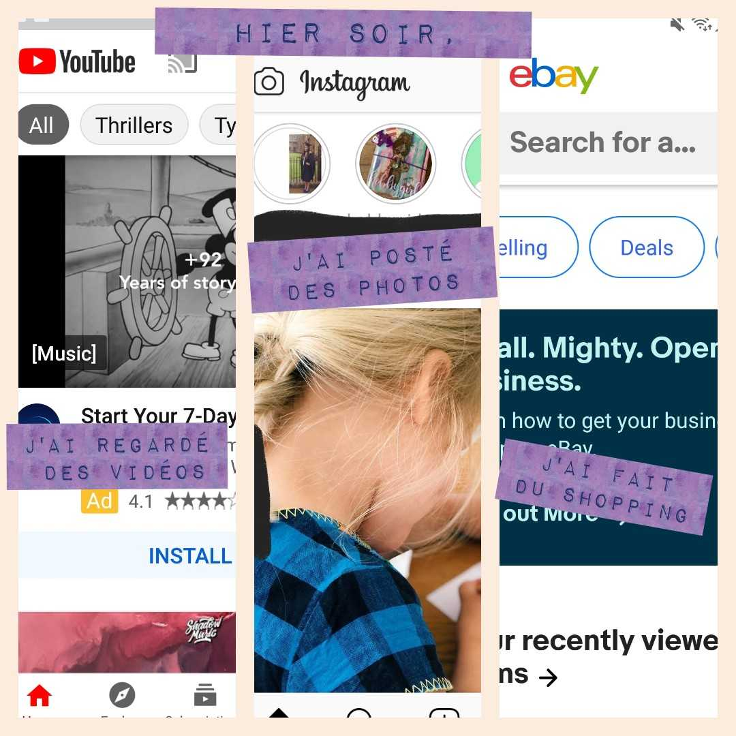
fun activities with a language twist
French Pic-Collage competition
Ce que je fais en ligne
Use the following prompts to create photo collages in French and send them back to your teacher for rewards.
You can use any free apps and take your own pictures for ease of use.
Prompts:
Mes applis préférées sont…
J’utilise mon portable pour…
Je ne me sers jamais de mon portable pour…
Hier soir, …
Demain, je vais…
Je suis accro, donc je devrais…
Example: Hier soir, …
Challenge:
Create your own prompts in French!
© We Teach French | www.weteachfrench.co.uk
Notes:
"Icon made by Skyclick from www.flaticon.com"
"Icon made by Freepik from www.flaticon.com"

Slide 3
fun activities with a language twist
French Pic-Collage competition
Les vêtements
Use the following prompts to create photo collages in French and send them back to your teacher for rewards.
You can use any free apps and take your own pictures for ease of use.
Prompts:
Ce que j’aime porter le weekend…
Mon uniforme est…
Vous ne me verrez jamais porter…
Hier, j’ai porté…
Demain, je vais porter…
Si je pouvais m’habiller comme je voulais au collège, je porterais…
Example: Demain, je vais porter…
Challenge:
Create your own prompts in French!
© We Teach French | www.weteachfrench.co.uk
Notes:
"Icon made by Darius Dan from www.flaticon.com“
"Icon made by dDara from www.flaticon.com"

Slide 4
fun activities with a language twist
French Pic-Collage competition
Mon temps libre
Use the following prompts to create photo collages in French and send them back to your teacher for rewards.
You can use any free apps and take your own pictures for ease of use.
Prompts:
Quand il pleut, …
Quand il fait chaud,…
Il est hors de question de…
Le mois dernier, mes amis et moi….
Quand on pourra enfin sortir, je vais…
Si je pouvais faire n’importe quoi, je voudrais…
Example: Il est hors de question de…
Challenge:
Create your own prompts in French!
© We Teach French | www.weteachfrench.co.uk
Notes:
"Icon made by Freepik from www.flaticon.com"

Slide 5
fun activities with a language twist
French Pic-Collage competition
Ma famille
Use the following prompts to create photo collages in French and send them back to your teacher for rewards.
You can use any free apps and take your own pictures for ease of use.
Prompts:
Dans ma famille, il y a …
Je m’entends bien avec…
Je ne supporte pas…
Hier, avec ma famille,…
Le weekend prochain, ma famille et moi, nous allons…
Example: Je m’entends bien avec…
Challenge:
Create your own prompts in French!
© We Teach French | www.weteachfrench.co.uk
Notes:
"Icon made by Monkik from www.flaticon.com"

Slide 6
fun activities with a language twist
French Pic-Collage competition
Là où j’habite
Use the following prompts to create photo collages in French and send them back to your teacher for rewards.
You can use any free apps and take your own pictures for ease of use.
Prompts:
J’habite…
Ma chambre…
La pièce préférée chez moi, c’est…
Avant, j’habitais…
A l’avenir, je vais habiter…
Si je pouvais habiter n’importe où, je choisirais…
Example: Si je pouvais habiter n’importe où, je choisirais…
Challenge:
Create your own prompts in French!
© We Teach French | www.weteachfrench.co.uk
Notes:
"Icon made by Freepik from www.flaticon.com"

