Slide 1
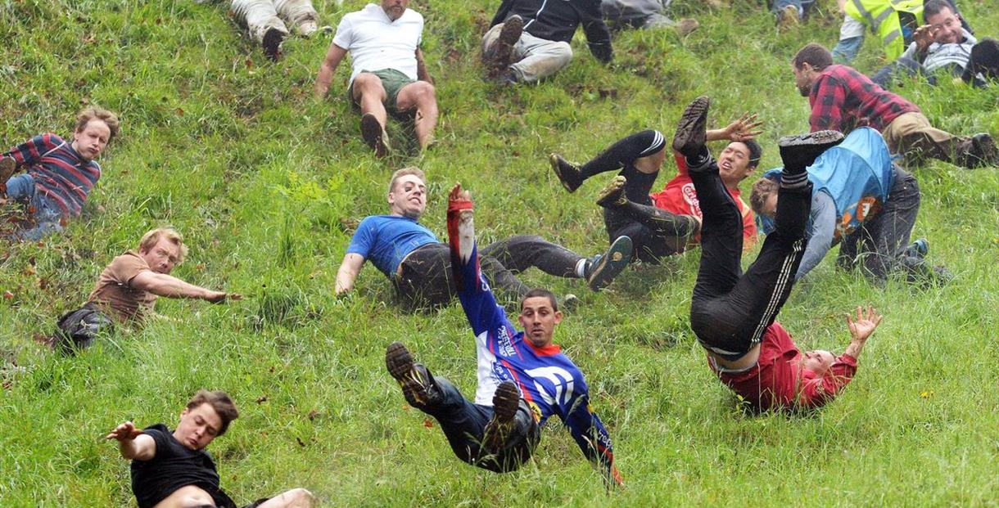
Which country?
Cheese Rolling
Germany
England
Switzerland
This tradition has been held for 200 years in Gloucester. Each year on the last Monday in May, participants stand on top of the Coopers Hill waiting for an enormous wheel of Double Gloucester Cheese to roll down the hill. When the cheese starts rolling, everyone tries to chase it while slipping, tripping and tumbling down the way. The first one who catches the cheese can keep it!
© WE TEACH MFL

Slide 2
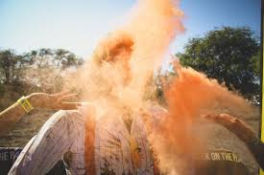
Which country?
Throwing cinnamon at single people
Denmark
Italy
Hungary
When you turn 25 years old, are unmarried and celebrating it in Denmark we advise you not to wear your best cloths. In Denmark it is a tradition that your friends ambush you on your birthday with a cinnamon shower all day. If that isn’t already bad enough, you should see what happens 5 years later when you turn 30 and you still haven’t been married. The spice is upgraded to pepper!
© WE TEACH MFL

Slide 3
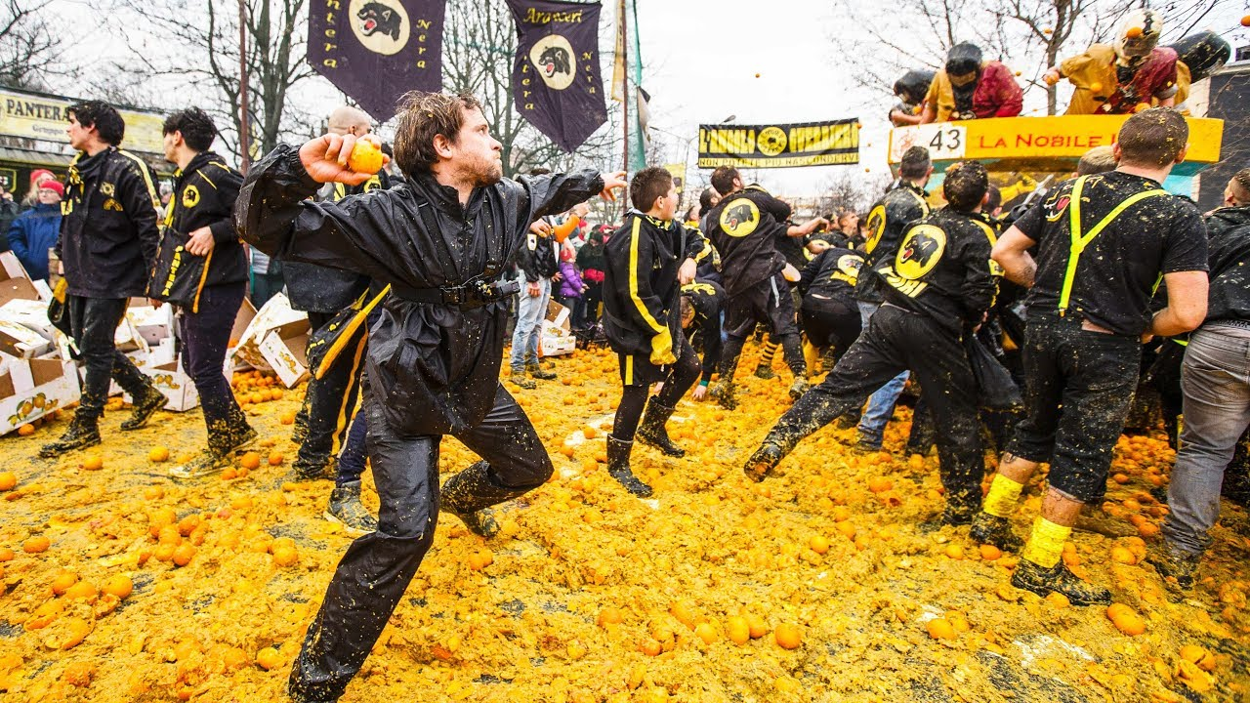
Which country?
Battle of the oranges
Ireland
Italy
Estonia
During the ‘Carnevale di Ivrea’ the people of the city Ivrea recreate a historic fight between the people and a ruling tyrant. However the battle isn’t fought with guns and swords. Instead of that they use oranges. More than 500.000 grams of fresh oranges are bought for this ‘Battaglia delle Arance’ (Battle of the Oranges). It is a festival rich in history and highlighting the fight for freedom.
© WE TEACH MFL

Slide 4
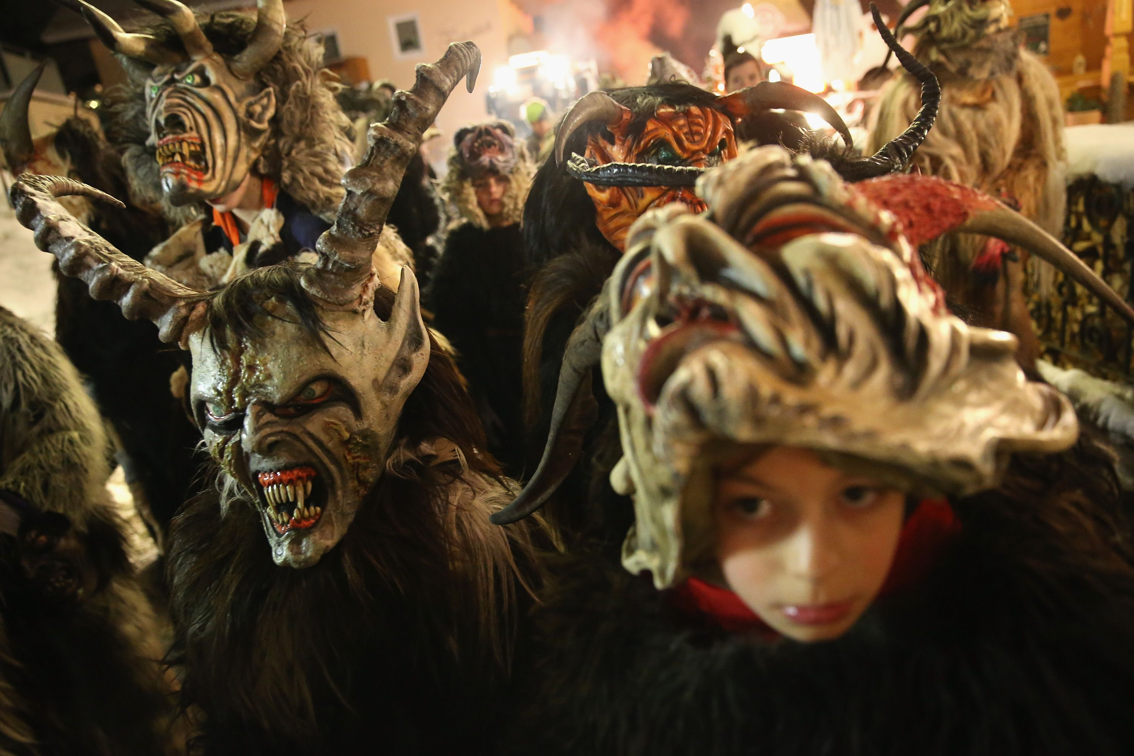
Which country?
Krampus Night
Malta
Romania
Austria
Merry – or not so merry – Christmas, you decide when traveling to Austria Christmas. There you will meet Krampus, the Bad Santa. He is a half-goat, half-demon who scares children into being nice and not naughty. According to the folklore, Krampus shows up in towns the night before December 6 which is known as Krampusnacht. During this night people get dressed as Krampus, as scary as possible, and celebrate in the streets.
© WE TEACH MFL

Slide 5
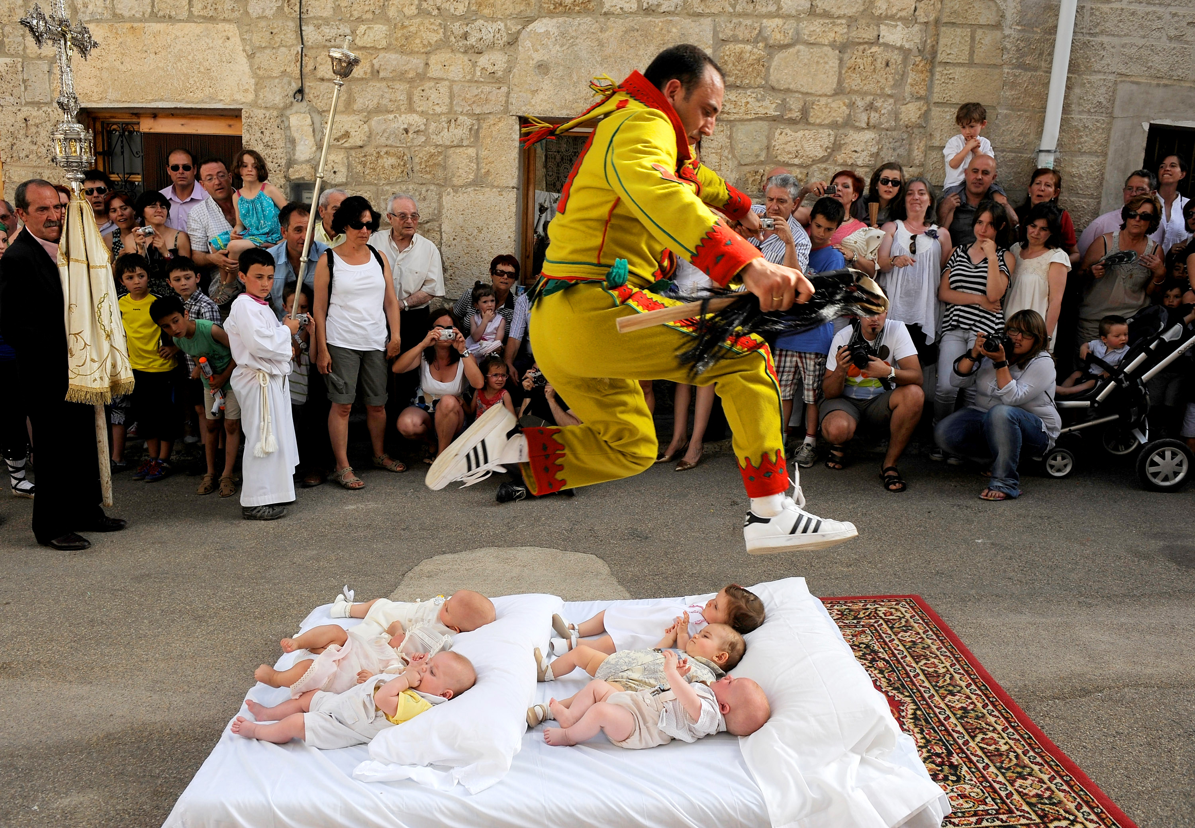
Which country?
Baby Jumping
Greece
Spain
Malta
Residents in a small Northern Community take part in baby jumping, called El Colacho, to keep the devil at bay. Men dressed as the devil run between and jump over infants, who are laid on mattresses along the streets.
© WE TEACH MFL

Slide 6
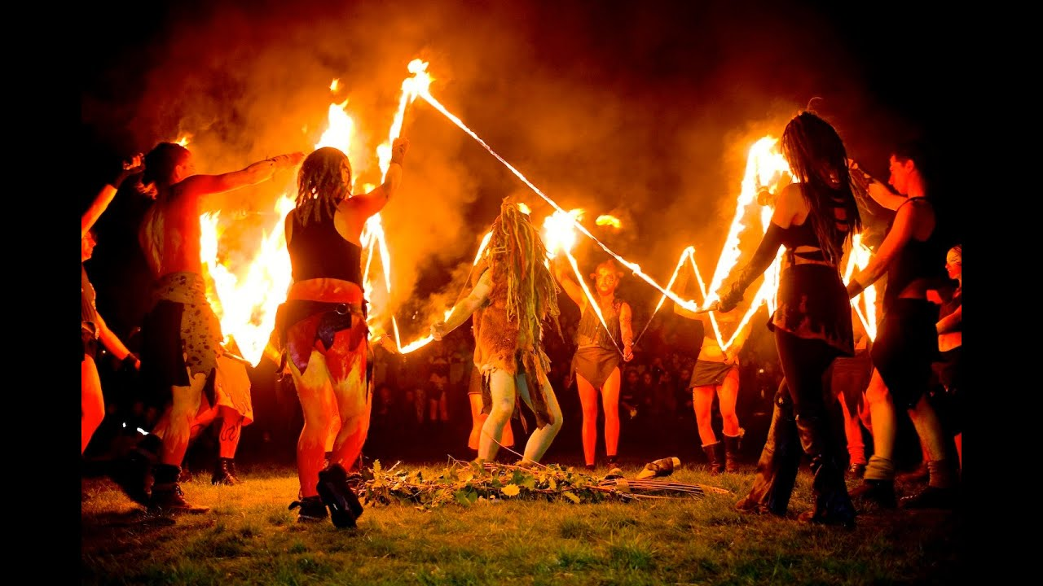
Which country?
Prague has more than its fair share of rituals and traditions, one of which sees young lovers jump over the dying embers of bonfires. Single men are also encouraged, on this day, to leave tokens of freshly cut branches on the doorstep of the women of the affections. It was once believed that the evil powers on this evening, which falls in between the ancient feast days of St. Jacob and St. Phillip, were far stronger than normal and that for this evening only they ruled over the good. Flocks of witches riding broomsticks were said to soar the skies, and the Czechs believed that the bonfires would bring them down in flames. Nowadays the celebration is far more light-hearted, and the biggest bonfire in the country takes place in the center of the Czech capital.
Witches Night
Czech Republic
Estonia
Belgium
© WE TEACH MFL

Slide 7
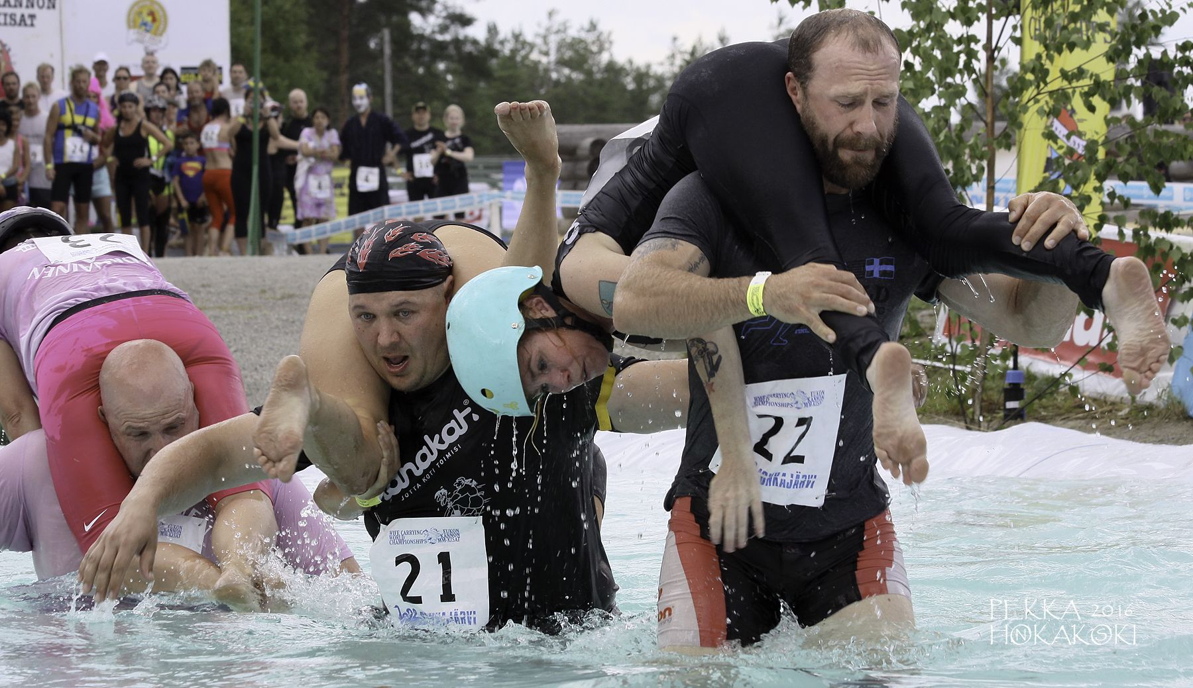
Which country?
Wife Carrying
Lithuania
Sweden
Finland
Believe it or not, wife carrying is a sport in Finland where men compete in a special obstacle track, carrying their wife on their back. It is a bit unclear how this competition originated in Finland. Legends have been passed down from generations to generations about a 19th century man named Herkko Rosvo-Ronkainen who was a robber accused of stealing food and women in villages in the area he was living in. It is believed that he used to carry them on his back as he ran away…
© WE TEACH MFL

Slide 8
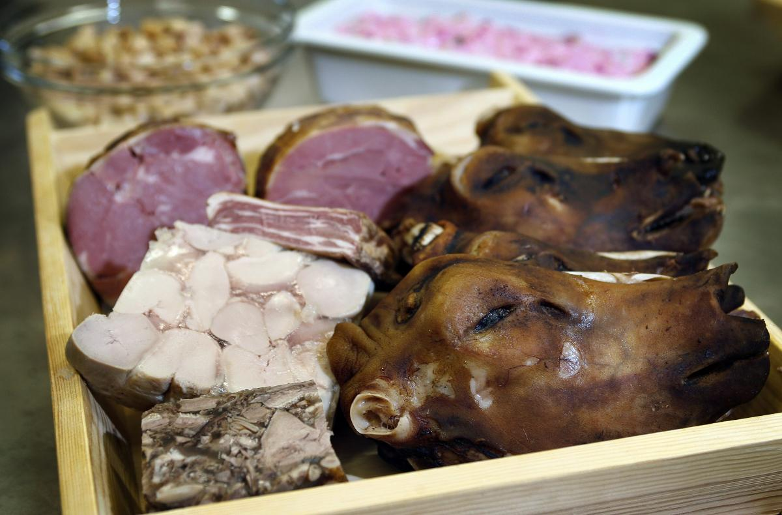
Which country?
The Month of Þorri
Iceland
Croatia
Latvia
In January many Icelanders celebrate the “feast of Thorri” and eat the worlds’ most disgusting food, consisting of sour ram testicles, boiled sheep heads, blood pudding, liver sausage and fermented shark. The Thorri is depicted in manuscripts from the middle ages as a personification of winter. It is unclear how the feasts were celebrated back then, but it seems clear that people had a great party with much food and drink. In modern Icelandic culture, eating Thorri food is also a sign of personal strength. Bon Appétit!
© WE TEACH MFL

